Slide 2
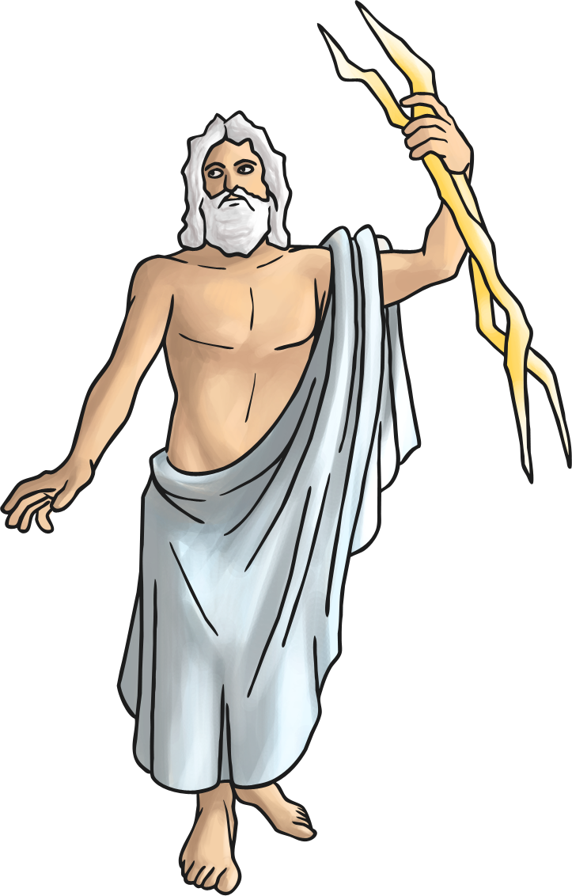
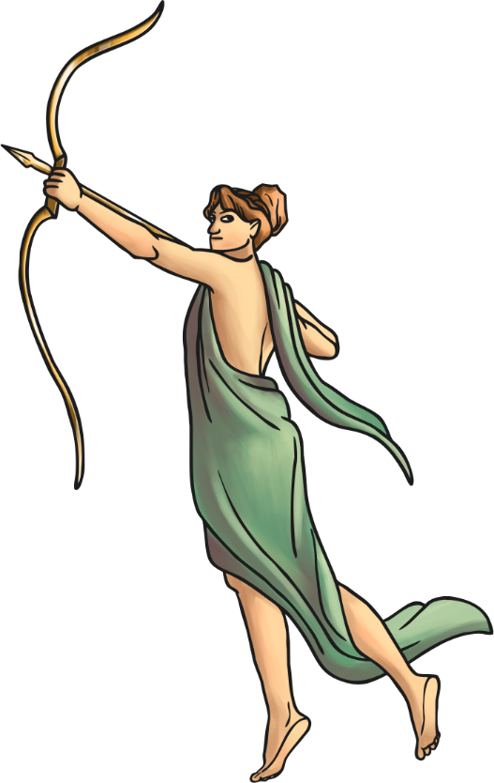
Roman Facts
The modern calendar, 12 months and 365 days,
was created by the Romans.
Romans believed in Gods and Goddesses who ruled over different areas of life. They built temples for them and took them offerings.

Slide 3
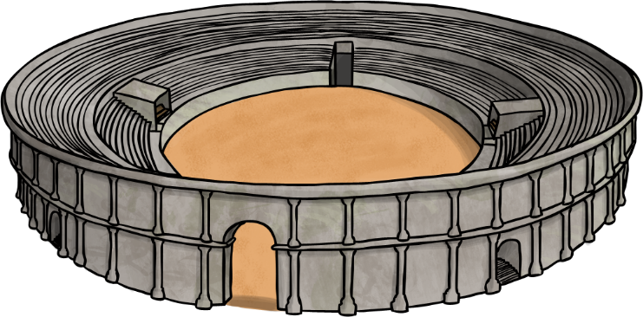
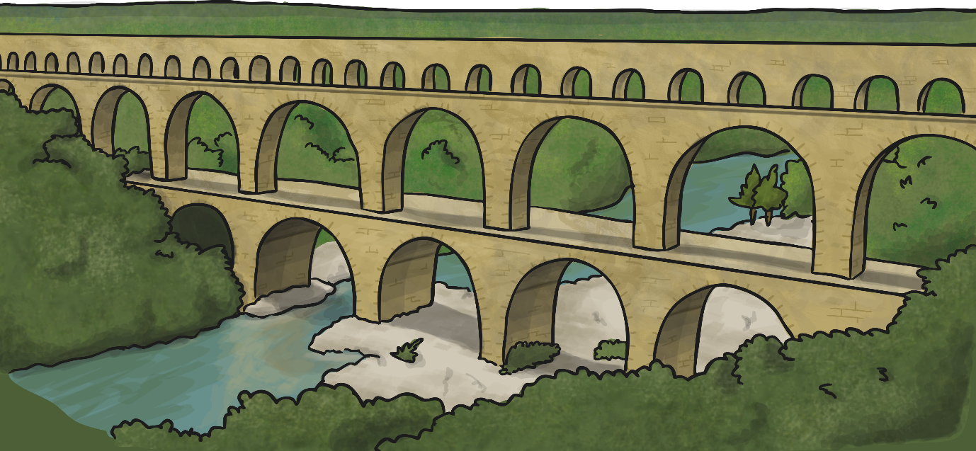
Roman Facts
Rome was founded in 753BC and quickly became a rich and powerful city.
The Romans were amazing architects and engineers. They built roads and walls.

Slide 4
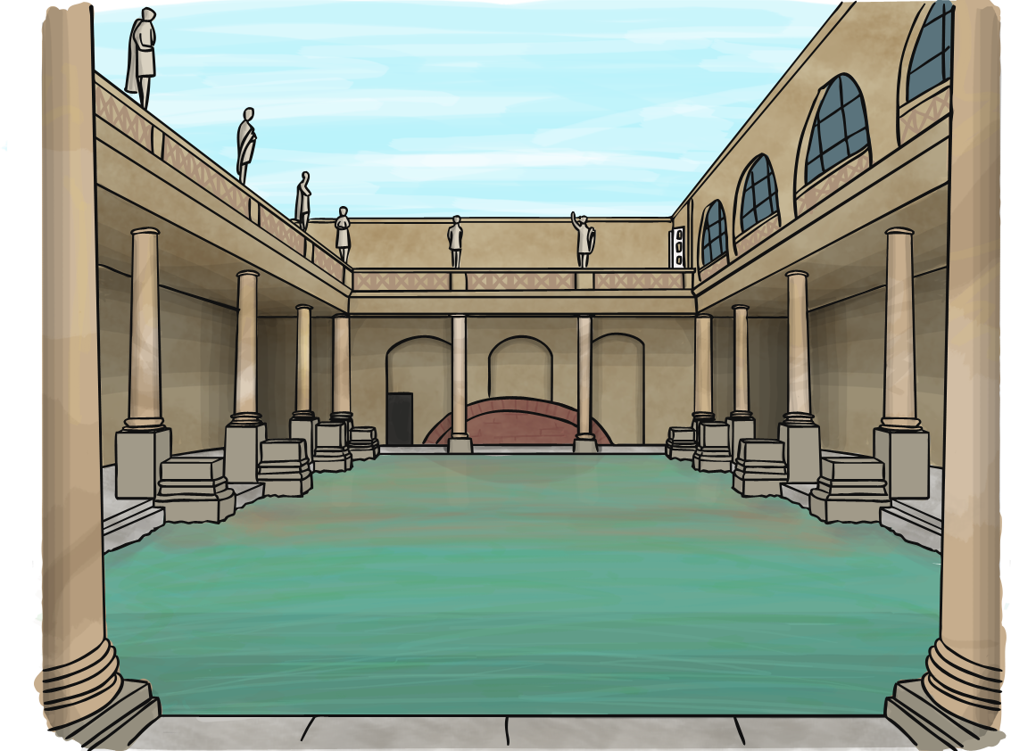
Roman Facts
Urine was collected from the bathhouses to be used for laundry and medicine.
Instead of toilet paper, the Romans used a wet sponge on the end of a stick.

Slide 5
Roman Facts
Education was very important and all children were taught to read and write. Children were taught through fear of being beaten if they got something wrong.

Slide 6
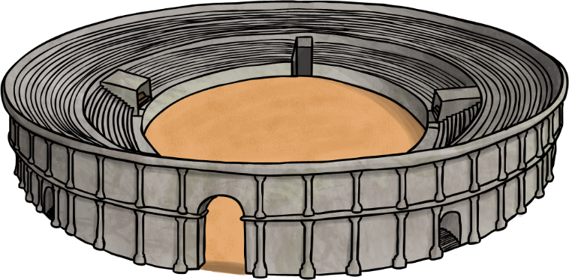
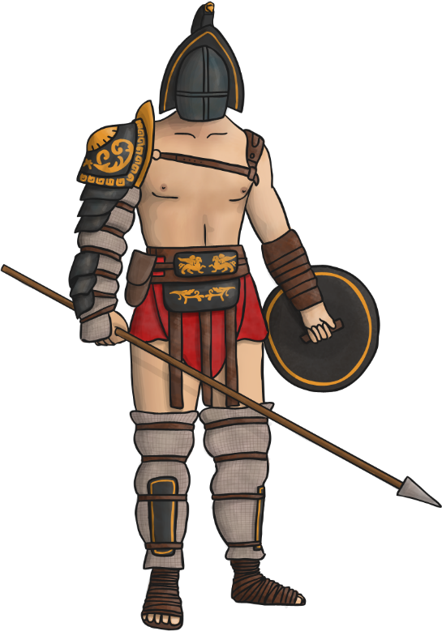
Roman Facts
Gladiators were both professional and amateur fighters. They fought to entertain Roman citizens.
Gladiators would fight each other as well as wild animals, such as lions and bears.

