Slide 1
INDIA
By Daniel

Slide 2
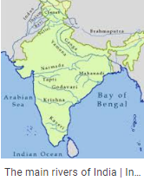
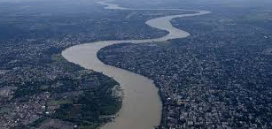
Rivers
Nearly all rivers in India flow East.
The rives that flow West include : Narmada River, Tapti River, Mahi River and Sabarmati River.
The longest river is the Ganges river it is 2,525km long

Slide 3
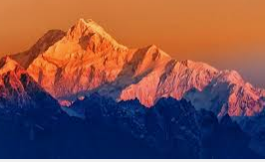
MOUNTAINS
There are seven mountain ranges in India
The highest mountain in India is called Kangchenjunga at 8,586m

Slide 4
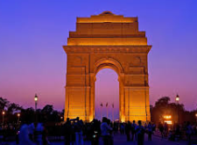
CITIES AND STATES
New Delhi is the capital city of India
Mumbia is the most populated city in India at 12,442,373
Delhi is the second most populated in India at 11,007,835
Bangalore is the third most populated city in India at 8,436,675

Slide 5
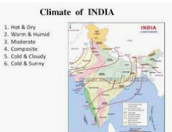
Climate
The climate of India comprises a wide range of weather conditions across a vast geographic scale and varied topographic
India has a tropical monsoon type of climate.
The word monsoon has been derived from the Arabic word Mausim, which means seasonal reversal of the winds during the course of the year.

Slide 6
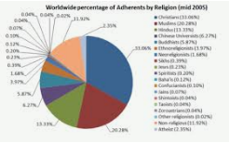
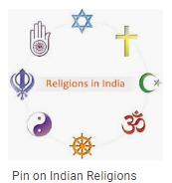
Religion
The major religions of India are:
Hinduisim
Islam
Sikhsim
Chrisitanity
Buddhism
Dainism
Zoroastrianism
Judaism
Baha I Faith

Slide 7
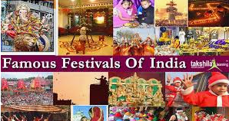
Feasts & Festivals
The 8 most popular festivals in India are:
Holi – also referred to as the festival of colours
The spectacular 11 day Ganesh festival honours the birth of the God Lord Ganesha
Navarati, Durga Puj and Dussehra is the 9 days of the festival honour the mother Goddess Durga in all her reincarnatations
Diwali honours the victory over good and evil, and brightness over darkness
Dnam is the biggest festival of the year in the South Indian state of Kerala
Krishna Janmashtami also known as the as the Govinda commorates the birthday of Lord Krishna
Pushkar camel fair is when an astonishing number of camels converse on the tiny desert town of Pushkar
Temple festivals - Kerla has many temples that hold annual festivals in honour of the presiding local God or Goddess

Slide 8
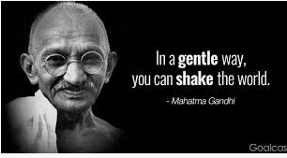
Famous people
Mohandas Mahatma Gandhi – the father of the nation and peace activist
Advani - Senior leader of the BJP political party
Ehagatsingh – Indian revolutionary during the 1920’s and 1930’s
Cyrus Mistry – current chairman of the Tata Group since 2012
Akbar – A Mughal Emperor from the 1500’s
Ranbir Kapoor – Current Bollywood actor, known for his wit and charm
Mary Kom – Indian boxer and Bronze medallist at the 2012 Olympics
M.F Hussain – one of the most celebrated Indian painters of the modern era
Guru Nanak – founder of the Sikkism, first of the Sikh Guru’s
Amish Tripathi – Author of the recent hit ‘Shiva’ triliogy

Slide 9
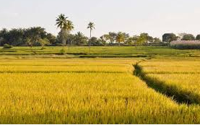
Food and Farming
Farming systems in India are strategically utilised according to the locations to where they are most suitable.
The farming system that significantly contributes to the agriculture of India is subsistence farming
Indian cuisine consists of a wide variety of regional and traditional cuisine native to the Indian subcontinent given the range of diversity in soil type, climate, culture, economic groups and occupations.
These cuisines vary substantially from each other and use locally available spices, herbs, vegetable and fruits.

Slide 10
The End
Hope you’re keeping good Mrs.Galvin ;-)

