Slide 1
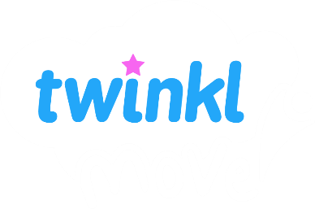
Gymnastics: Traditional Tales
Year One
PE | Year 1 | Indoor | Gymnastics: Traditional Tales | The Three Billy Goats Gruff | Lesson 1

Slide 3
Aim
To recognise and perform contrasting movements and balances.
Success Criteria
I can create different shapes with my body and hold them still.
I can perform a range of controlled balances.
I can choose and perform two contrasting balances.

Slide 4
Let’s Get Ready

Slide 5
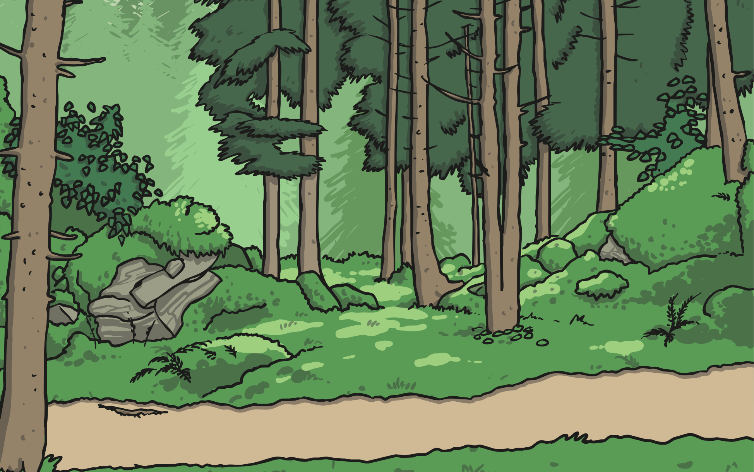
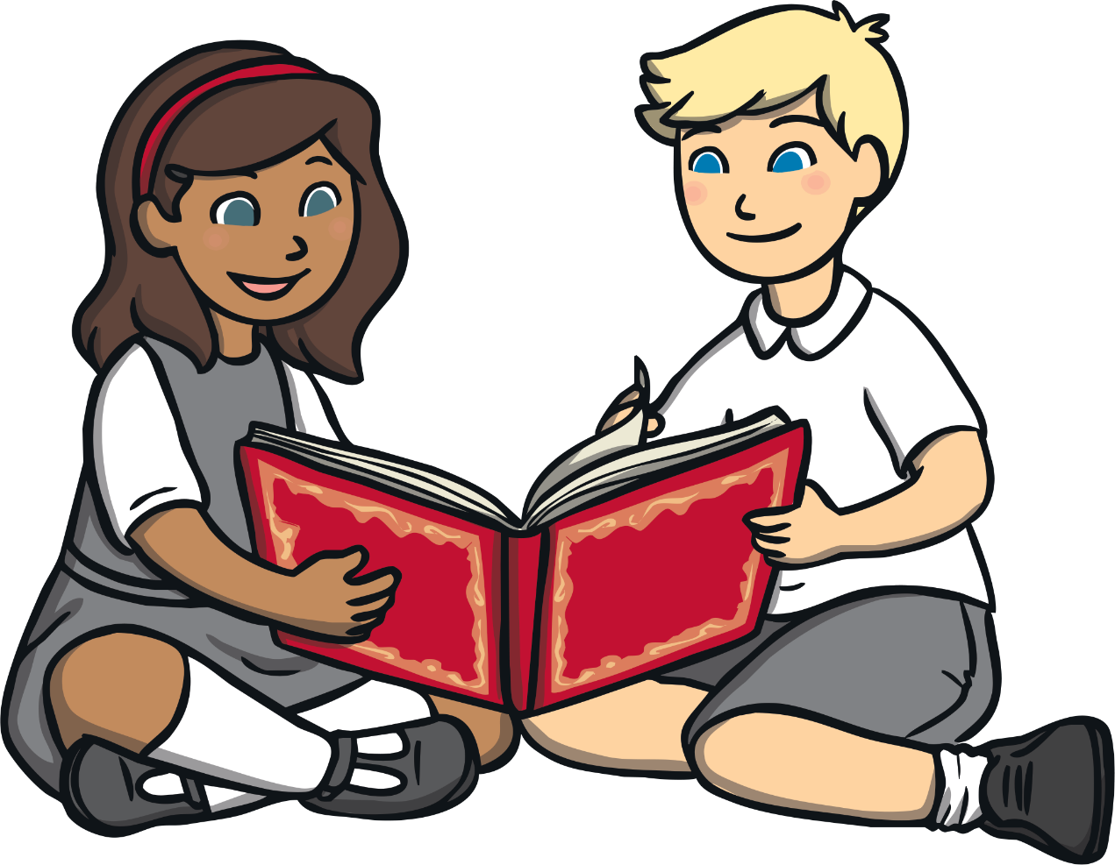
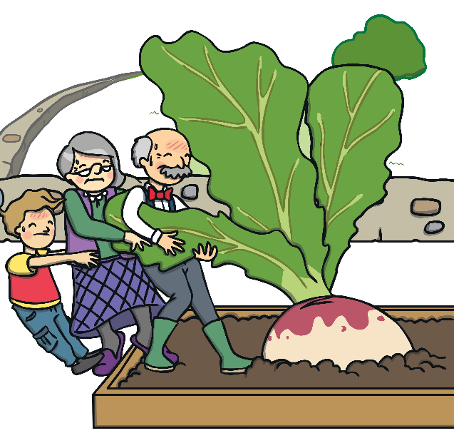
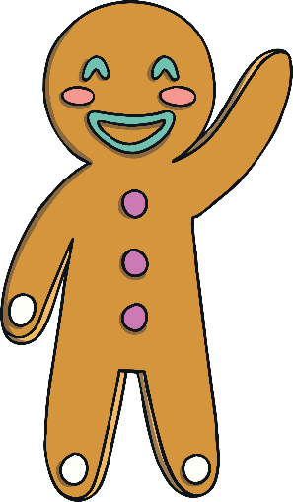
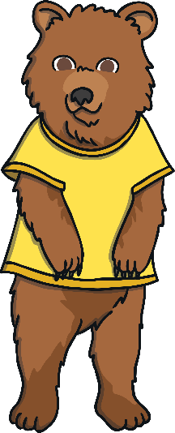
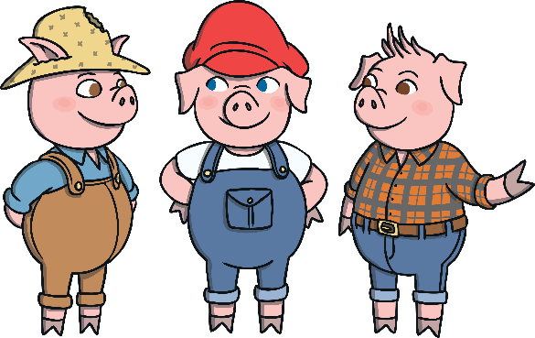
Traditional Tales
Do you recognise any of these characters from the
stories that we are going to use?
In this gymnastics unit, we are going to use some stories to help us with our learning. Each story will help us to practise different gymnastic skills.
You might have read some of these stories before and they are called traditional tales. They are known by lots of people.

Slide 6
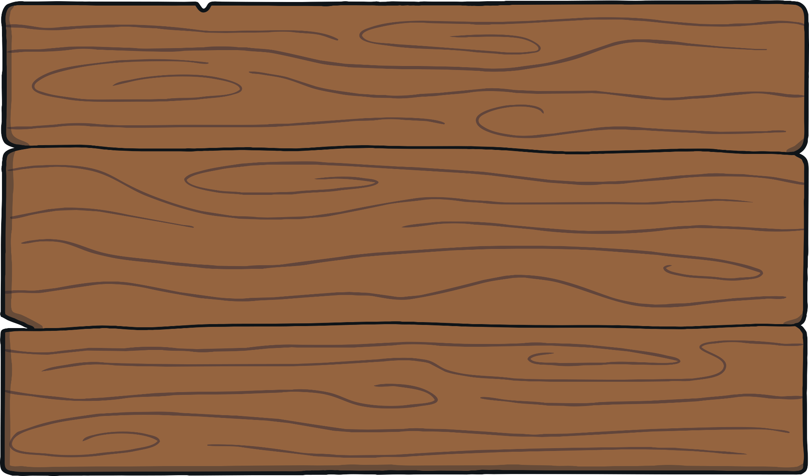
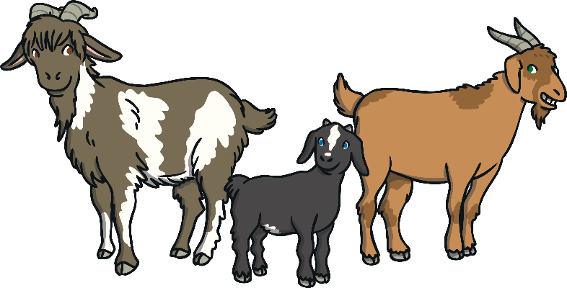
The Three Billy Goats Gruff
In our first lesson, we are going to use the characters from The Three Billy Goats Gruff.
What do you notice about the size of each goat?
They are all different sizes. There is a small goat, a medium-sized goat and a large goat.
What do you know about this story?
In this story, there are three goats who live together on a hillside.

Slide 7
Let’s Get Moving

Slide 8
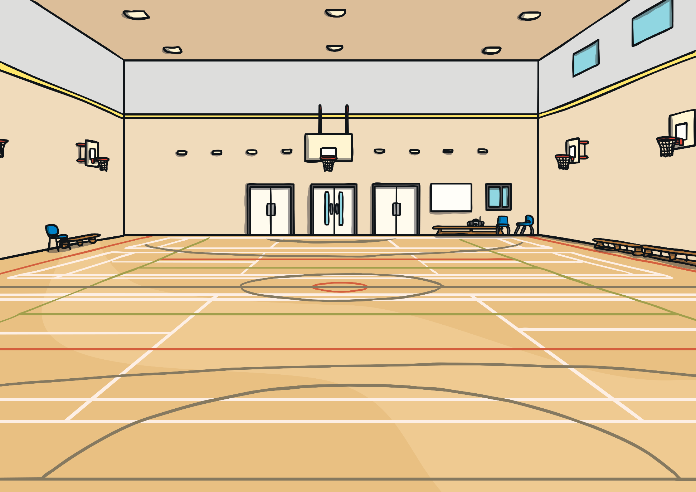
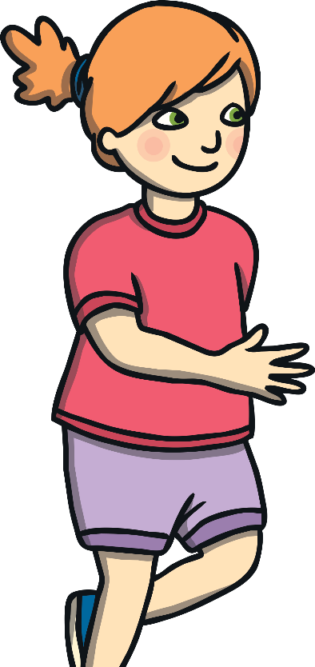
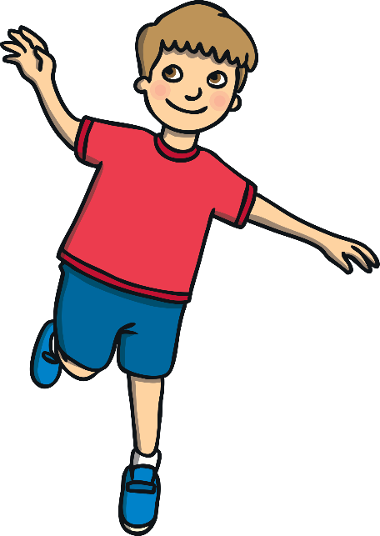
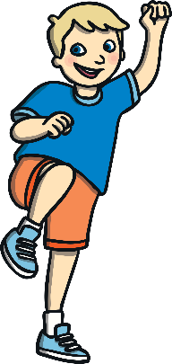
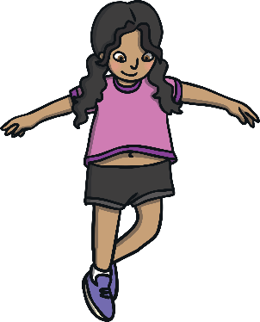
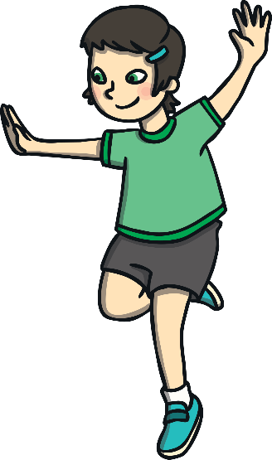
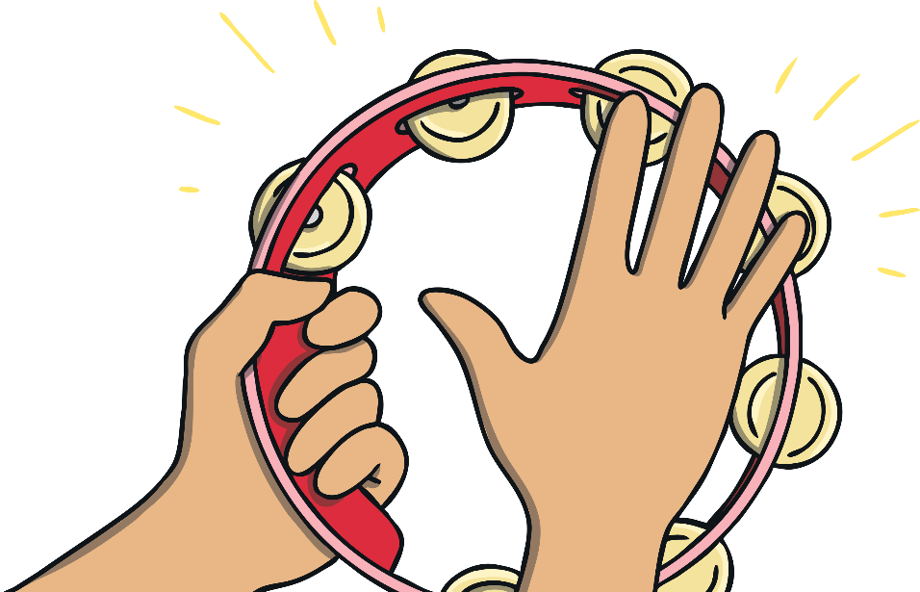
Warm-Up: Different Sizes
You are going to travel around the room in different ways.
When you hear the tambourine, you are going to freeze and then listen carefully to your teacher. You will make some different shapes with your body.
They will be contrasting shapes, which means that they will look very different.
narrow
big
small
wide

Slide 9
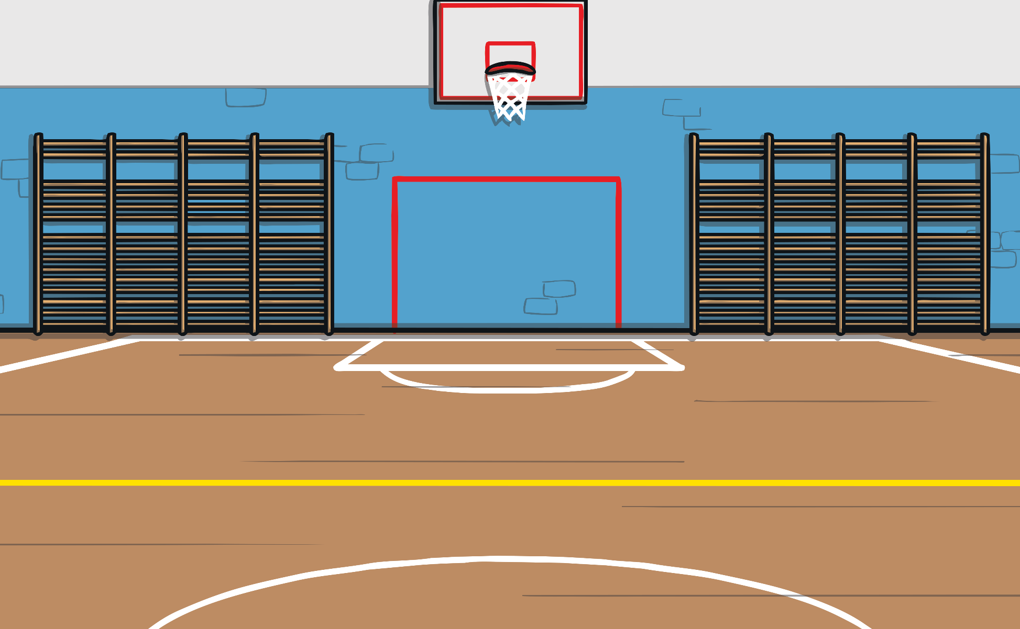
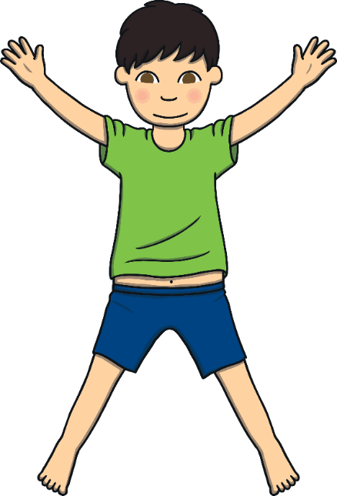
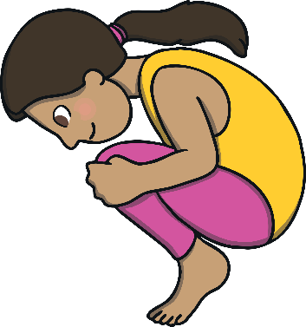
Star, Straight and Tuck
Look at these pictures of different body shapes.
Can you make these shapes with your body?
star
tuck
straight
Are you making a clear shape?
Are you holding your body still?

Slide 10
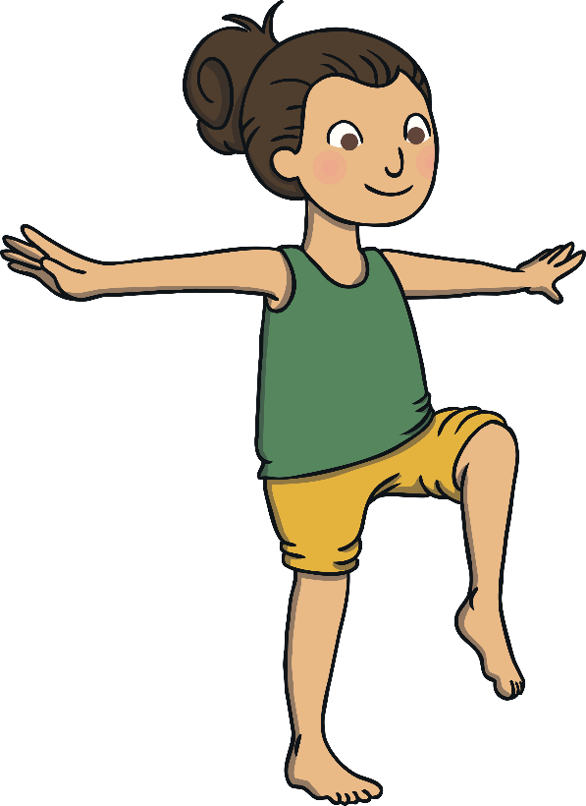
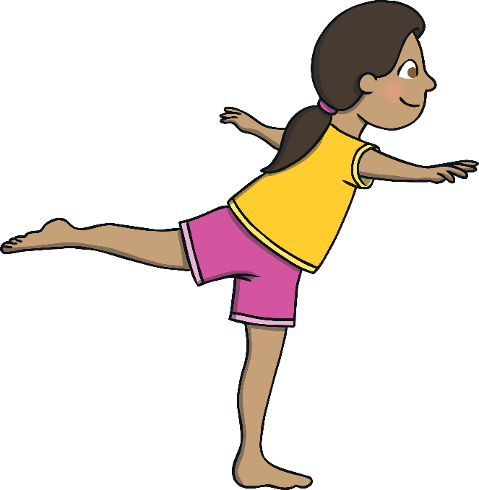
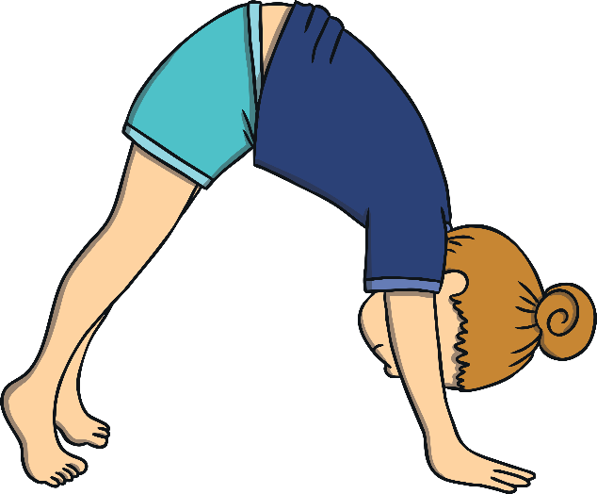
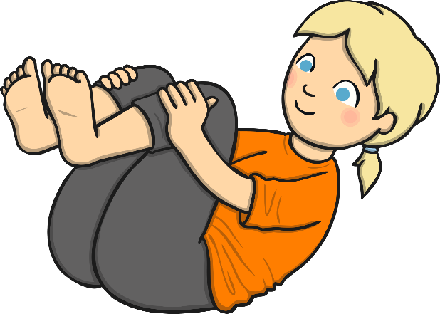
Balancing
Now you are going to try some different balances using the body shapes that you have practised.
What is a balance?
A balance is when you keep your body still in a particular shape.
Tense your body to keep your balance still.
Stretch the parts of your body as much as you can.
Stay in your balance for a few seconds.

Slide 11
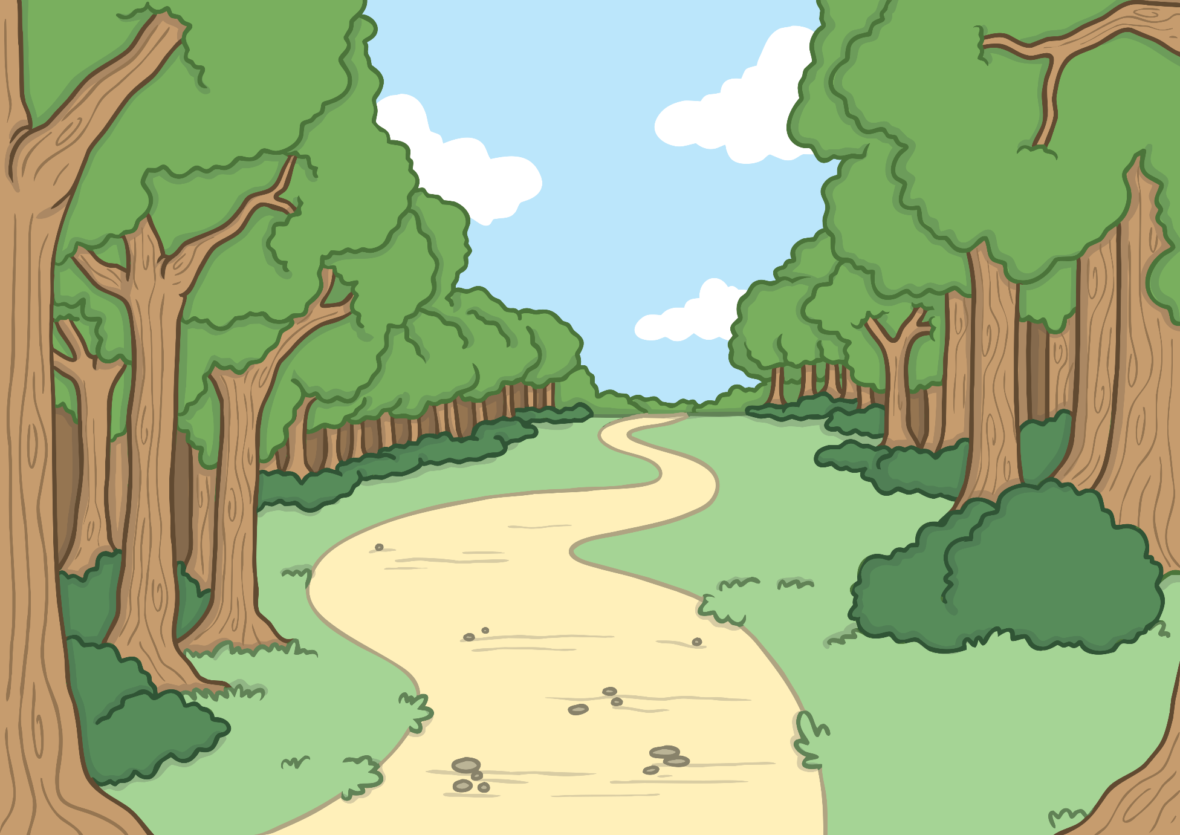
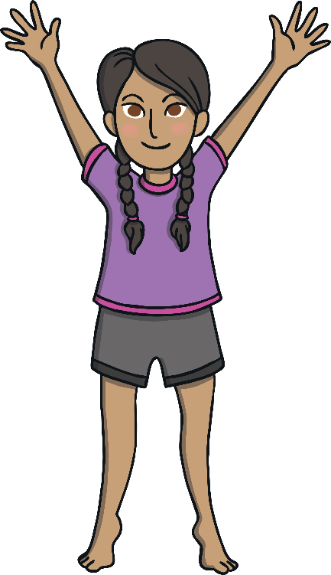
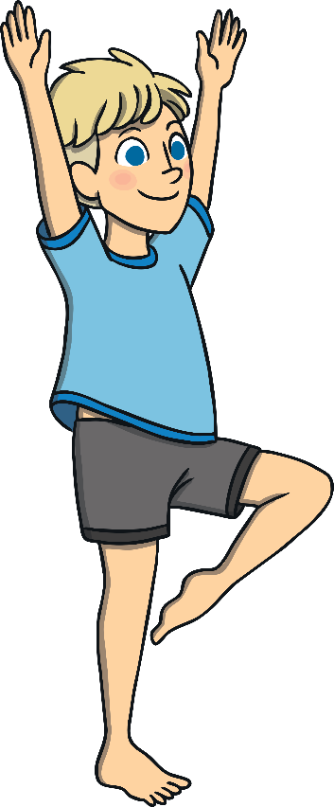
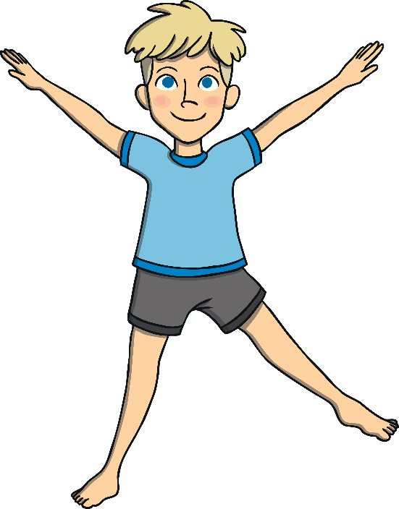
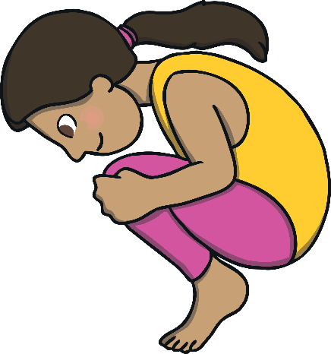
Balancing
Can you balance on your tiptoes in a straight shape?
Can you balance on your tiptoes in a star shape?
Can you lift one leg into an interesting position?
Can you lift one leg in your star shape?
Can you create a tucked shape on a different part of your body?

Slide 12
Time to Perform
Now you are going to perform some of the balances that you have practised.
You need to choose two different contrasting balances.
A big balance
A wide balance
or
or
A small balance
A narrow balance
still
stretch
stay

Slide 13
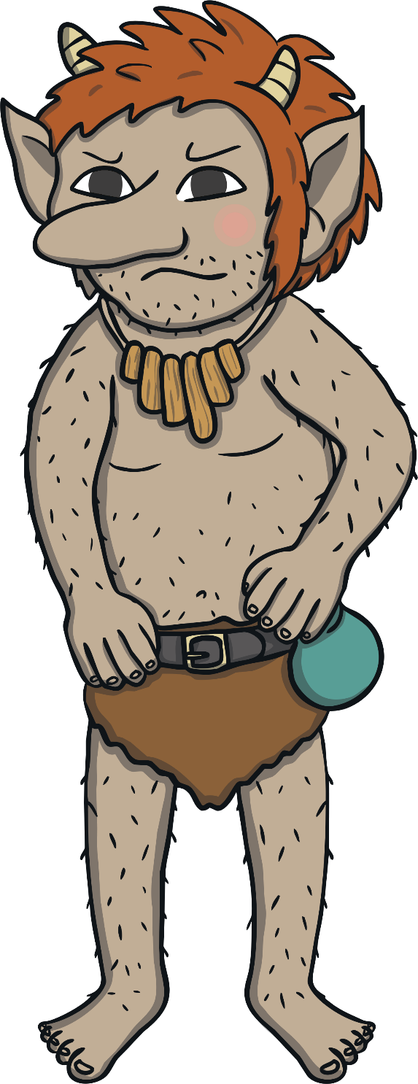
Cool-Down: Goats and Troll
To cool our bodies down, we are going to move like the three goats in the story.
When you hear the words of the troll, you need to freeze.
The smallest goat moves with tiny, quick steps.
The biggest goat moves more slowly with giant steps.
Can you move like the medium-sized goat?
Who’s that trip-trapping over my bridge?

Slide 14
Let’s Review

Slide 15
Different Body Shapes
Here are the shapes that you made with your body in today’s lesson. Tell your partner what each shape is called.
Did you name each shape correctly?
star
tuck
straight

Slide 16
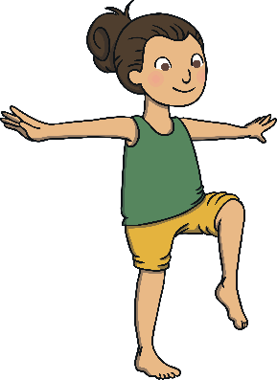
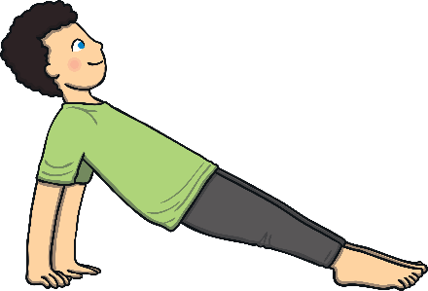
Contrasts
Here are pictures of some of the contrasting balances that you might have performed today.
Which word would you match to each balance?
wide
narrow
big
small

Slide 17
Aim
To recognise and perform contrasting movements and balances.
Success Criteria
I can create different shapes with my body and hold them still.
I can perform a range of controlled balances.
I can choose and perform two contrasting balances.

