Slide 1
Can we improve our flexibility and our strength?
Fourth class investigation

Slide 2
How many of us can touch our toes?
We first investigated this question on 9/1/2023
11/29 could do it
This is approximately 1/3 of the class
2/3 could not do it!
We will have to practice until we get better!

Slide 3
What exercises will we do?

Slide 4
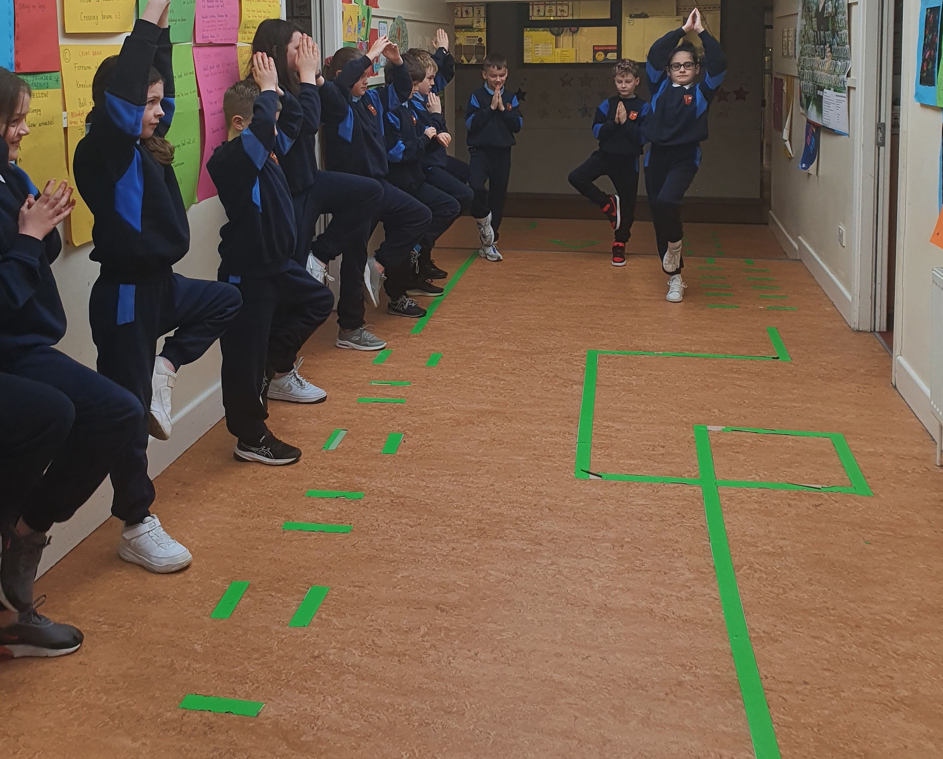
How long can we hold “The Tree” pose

Slide 5
With practice we are getting better 10/01/23

Slide 6
How long can we hold the tree? 20/02/23

Slide 7
Posters to explain our project

Slide 8
Investigating, observing, recording and presenting our results

Slide 9
What did you learn about yourself? Our reponses.
I am stronger 2
I am more flexible 11
I have better balance 1
I have more confidence 3
Nothing 4
I can try anything 7

Slide 10
What personal qualities do you need to do this?
Dedication 2
Patience 2
Self-belief 16
Determination 3
Confidence 3
Motivation 4

